Slide 1
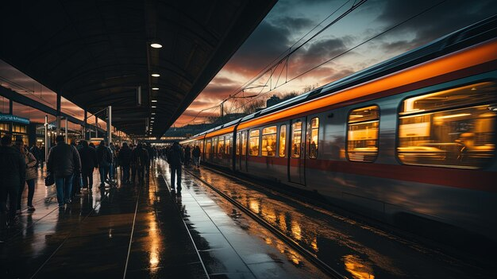
RAILWAY SYSTEM DATABASE
Vijay chirde
vijaychirde34@gmail.com
+91 9545154142

Slide 2
Dataset for Railway System
Tables
Trains
Stations
Tickets
Routes
Passenger

Slide 3
Retrieve all Trains departing from Delhi .
List all stations on the route of train 101.
Find the total distance covered by “Rajdhani Express”.
Get details of tickets booked on 2024-11-25.
Find all passengers travelling on “Shatabdi Express”.
Calculate the total revenue generated by train 101.
Find the station where train 101 arrives the latest.
List all express trains.
Count the number of trains passing through each station.
Identify passengers travelling from Delhi to Mumbai.
Find trains arriving at a station after 12.00 PM.
Retrieve the schedule of all trains along with their route sequence.

Slide 4
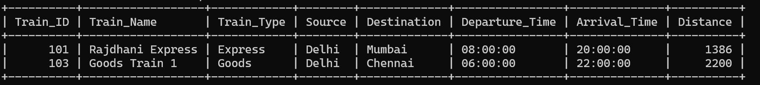
1. Retrieve all Trains departing from Delhi .
Code : SELECT * FROM Trains
WHERE Source = 'Delhi';
Output:

Slide 5
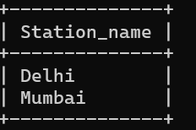
2. List all stations on the route of train 101.
Code : SELECT Station_Name FROM Routes
JOIN Stations ON Routes.Station_ID = Stations.Station_ID
WHERE Train_ID = 101;
Output:

Slide 6
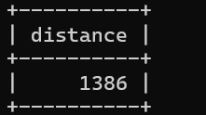
3. Find the total distance covered by “Rajdhani Express”.
Code : SELECT Distance FROM Trains
WHERE Train_Name = 'Rajdhani Express';
Output:

Slide 7
4. Get details of tickets booked on 2024-11-25.
Code : SELECT * FROM Tickets
WHERE Booking_Date = '2024-11-25';
Output:

Slide 8
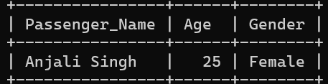
5. Find all passengers travelling on “Shatabdi Express”.
Code : SELECT Passenger_Name, Age, Gender FROM Tickets
JOIN Trains ON Tickets.Train_ID = Trains.Train_ID
WHERE Train_Name = 'Shatabdi Express';
Output:

Slide 9
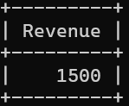
6. Calculate the total revenue generated by train 101.
Code : SELECT SUM(Fare) AS Revenue FROM Tickets
WHERE Train_ID = 101;
Output:

Slide 10
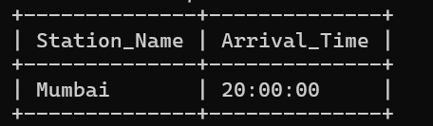
7. Find the station where train 101 arrives the latest.
Code : SELECT Station_Name, Arrival_Time FROM Routes
JOIN Stations ON Routes.Station_ID = Stations.Station_ID
WHERE Train_ID = 101
ORDER BY Arrival_Time DESC
LIMIT 1;
Output:

Slide 11
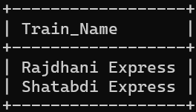
8. List all express trains.
Code : SELECT Train_Name FROM Trains
WHERE Train_Type = 'Express';
Output:

Slide 12
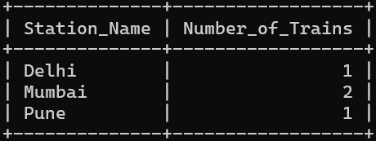
9. Count the number of trains passing through each station.
Code : SELECT Station_Name, COUNT(DISTINCT Train_ID) AS
Number_of_Trains FROM Routes
JOIN Stations ON Routes.Station_ID = Stations.Station_ID
GROUP BY Station_Name;
Output:

Slide 13
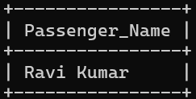
10. Identify passengers travelling from Delhi to Mumbai.
Code : SELECT Passenger_Name FROM Tickets
WHERE Source_Station_ID = (SELECT Station_ID FROM Stations WHERE Station_Name = 'Delhi')
AND Destination_Station_ID = (SELECT Station_ID FROM Stations WHERE Station_Name = 'Mumbai');
Output:

Slide 14
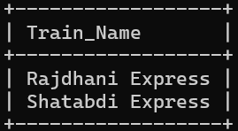
11. Find trains arriving at a station after 12.00 PM.
Code : SELECT Train_Name FROM Routes
JOIN Trains ON Routes.Train_ID = Trains.Train_ID
WHERE Routes.Arrival_Time > '12:00:00';
Output:

Slide 15
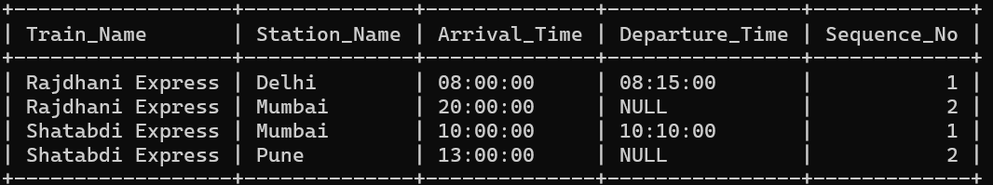
12. Retrieve the schedule of all trains along with their route sequence
Code : SELECT Trains.Train_Name, Stations.Station_Name, Routes.Arrival_Time, Routes.Departure_Time, Routes.Sequence_No FROM Routes
JOIN Trains ON Routes.Train_ID = Trains.Train_ID
JOIN Stations ON Routes.Station_ID = Stations.Station_ID
ORDER BY Train_Name, Sequence_No;
Output:

